Slide 1

A SEMINAR
ON
Major project stage - II
SMART AUTONOMOUS ROBOT USING GROQ AI
BACHELOR OF TECHNOLOGY
IN
ELECTRONICS & COMMUNICATION ENGINEERING
Under the esteemed guidance of
SHRI DR.M.SRINIVASA RAO B.E,M.Tech,Ph.D
Associate Professor
Presented by
B.SAIKIRAN (22J21A0403)
M.MEGHANA (22J21A0418)
M.NIKHIL (23J25A0418)
B.TARUN (22J21A0404)
2025-26

Slide 2
AGENDA:
Introduction
Block Diagram
Individual Block Diagram
Circuit Diagram
Software Requirements
Flow Chart
Result
Advantages
Applications
Conclusion
Future Scope
Reference

Slide 3
Introduction:
Aim: The main aim of this project is to design and develop a Smart Autonomous Robot that can recognize and respond to human voice commands to perform movements such as moving forward, backward, left, right, and stop, while also providing verbal responses through a speech system.
Previous: In earlier robotic systems, control was primarily achieved through manual or remote-operated mechanisms such as joysticks, switches, or infrared remote controls. These systems required continuous human intervention and physical input to perform even simple movements like moving forward or turning, which limited their efficiency and flexibility.
Propose: The proposed system introduces a Smart Autonomous Robot that overcomes the limitations of traditional manually controlled robots. This system allows the robot to be operated entirely through human voice commands, eliminating the need for physical input devices such as remotes or switches.

Slide 4
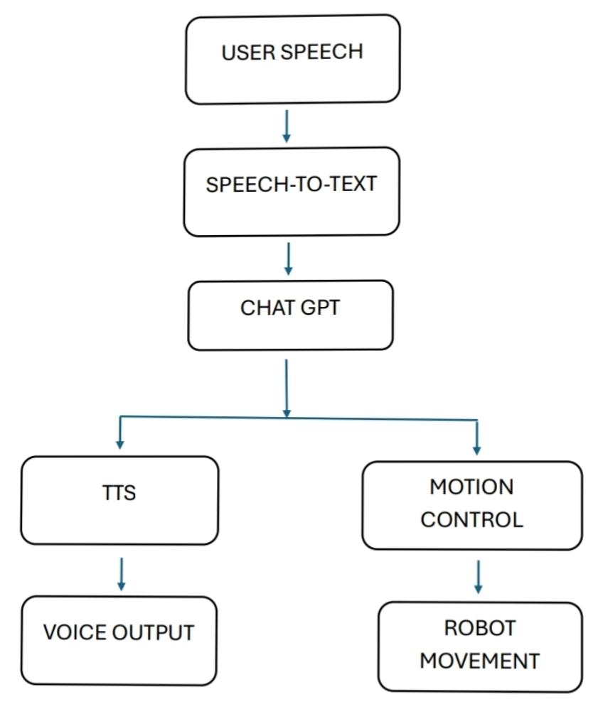
BLOCK DIAGRAM:
Camera
XPT2046
Ultrasonic sensors
Speaker
USB Mic
Motor Drivers
Dc Motor
Raspberry Pi

Slide 5
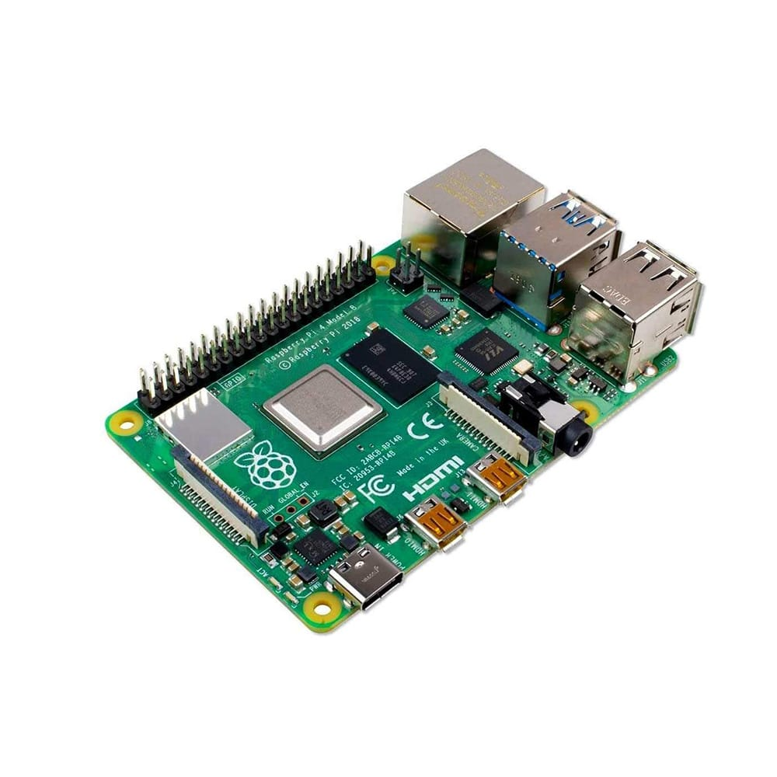
RASPBERRY PI 4
Purpose:
Acts as the main processing unit of the robot, responsible for executing voice commands, controlling hardware components, and managing communication between all modules.
Features:
Broadcom BCM2711 quad-core processor (1.5 GHz)
RAM: 2GB / 4GB / 8GB
Supports Python and Raspberry Pi OS
Built-in Wi-Fi and Bluetooth
GPIO pins for hardware interfacing
Power Supply: 5V, 2.5A–3A (≈ 12–15W)

Slide 6
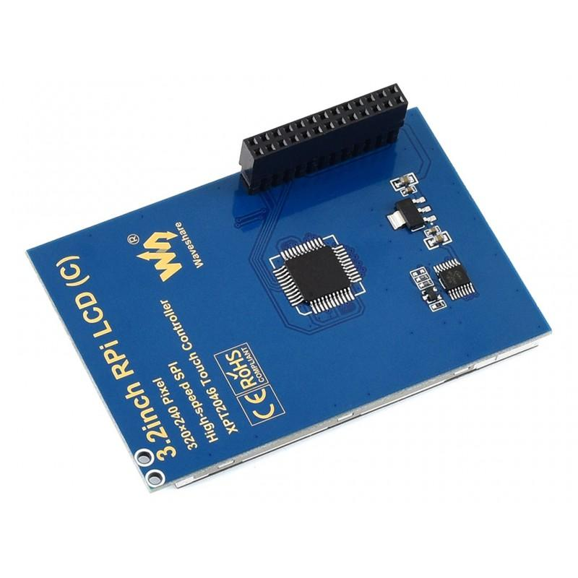
XPT2046:
Purpose:
Acts as a touch interface controller that detects user touch input on a resistive touchscreen and sends the touch coordinates to the Raspberry Pi, enabling interactive control of the robot system.
Features:
Supports resistive touchscreen input
Communicates using SPI protocol
High accuracy touch position detection
Low power consumption design
Compatible with Raspberry Pi and TFT displays
Converts analog touch signals into digital data
Power Supply: 2.2V – 3.6V (typically 3.3V), ≈ 1–5mW

Slide 7
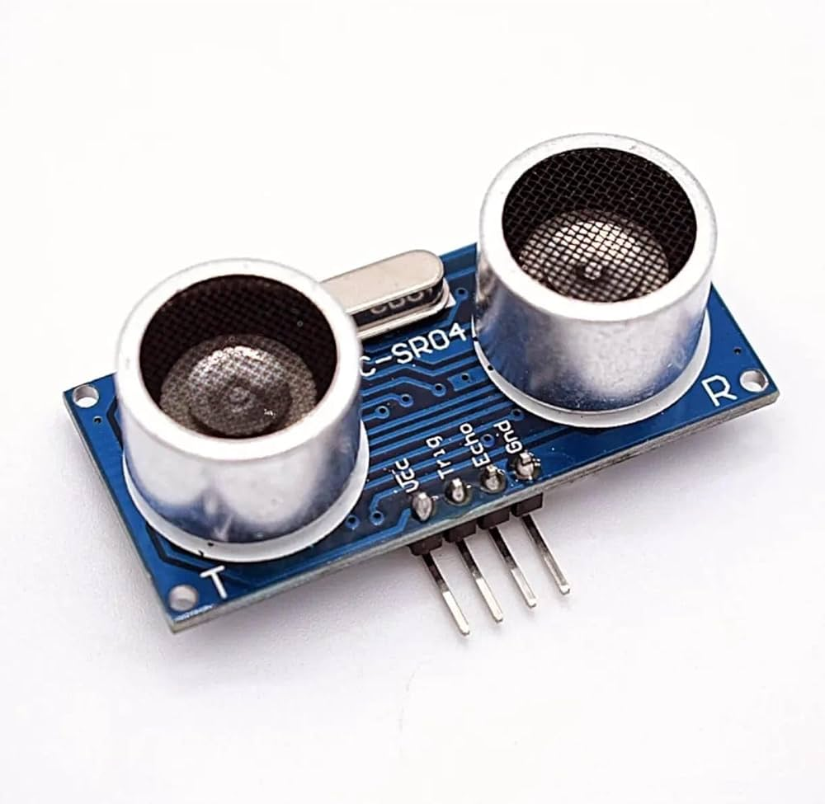
Ultrasonic sensors :
Purpose:
Detects obstacles by measuring distance using ultrasonic waves.
Features:
Frequency: 40 kHz
Range: 2 cm to 400 cm
High accuracy
Easy GPIO interfacing
Low cost
Power Supply: 5V, 15mA (≈ 0.075W)

Slide 8
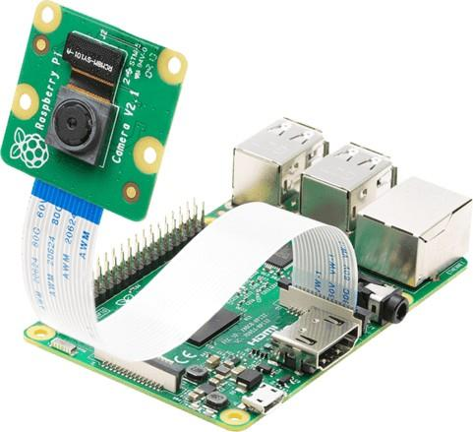
Camera:
Purpose:
Captures images/videos for vision-based tasks and AI applications.
Features:
High-resolution image capture
Real-time video streaming
CSI interface for fast communication
Supports OpenCV and AI processing
Lightweight module
Power Supply: 5V (≈ 250mA → ~1.25W)

Slide 9
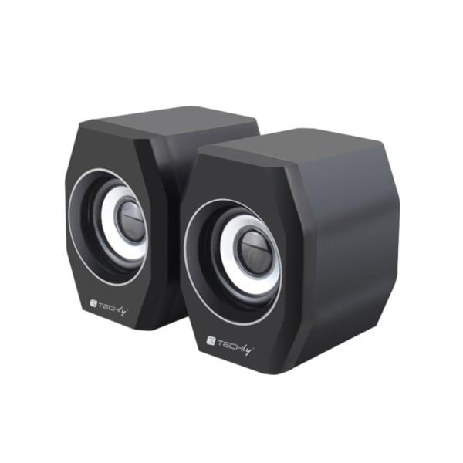
Speaker:
Purpose:
Provides voice output and audio feedback from the robot.
Features:
Converts digital signals into sound
Supports audio jack/USB connection
Clear sound output
Low power consumption
Compact size
Power Supply: 3W–5W (depends on volume and type)

Slide 10
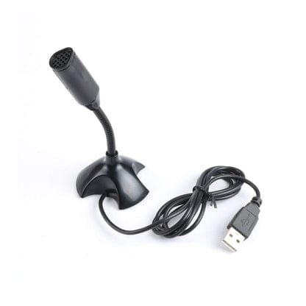
USB Mic:
Purpose:
Captures human voice commands and converts them into digital signals for processing.
Features:
USB plug-and-play device
High sensitivity voice input
Built-in ADC (Analog to Digital Conversion)
Compatible with speech recognition libraries
Compact design
Power Supply: 5V via USB (≈ 0.1–0.5W)

Slide 11
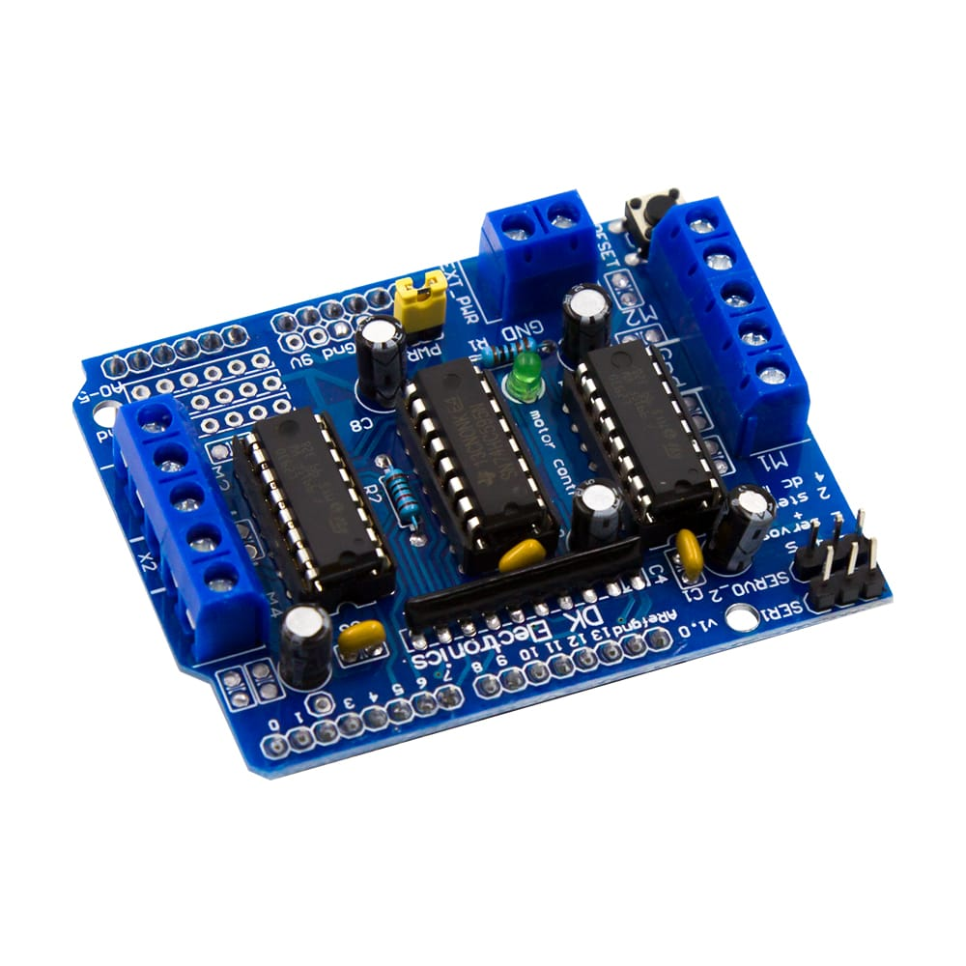
Motor Drivers :
Purpose:
Controls direction and speed of motors by amplifying signals from Raspberry Pi.
Features:
Dual H-bridge motor control
Controls two motors simultaneously
High current capability
Direction and speed control
Wide voltage range
Power Supply: 5V logic + 7V–12V motor supply (≈ up to 25W depending on motors)

Slide 12
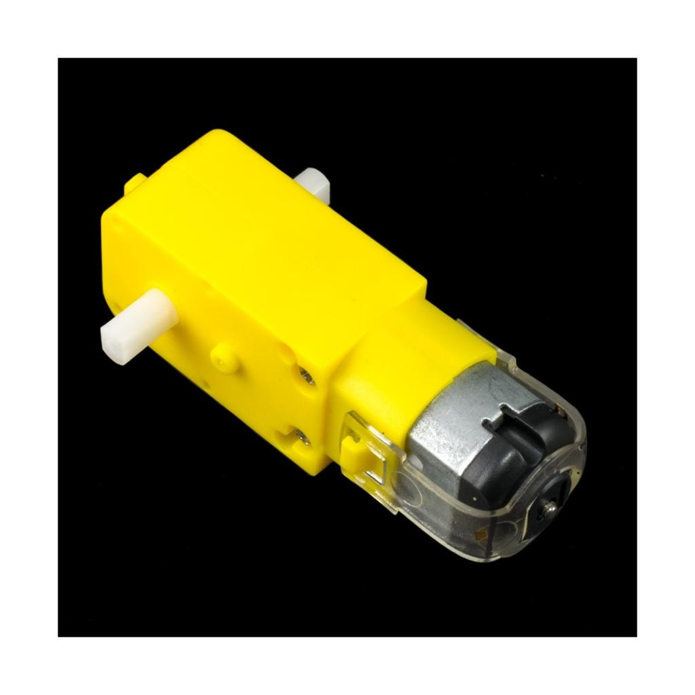
DC MOTOR:
Purpose:
Provides movement to the robot by converting electrical energy into mechanical motion.
Features:
Forward and reverse rotation
High torque for movement
Compatible with motor driver
Supports wheels and gear systems
Durable and efficient
Power Supply: 6V–12V, 100mA–500mA per motor (≈ 1W–6W each)

Slide 13
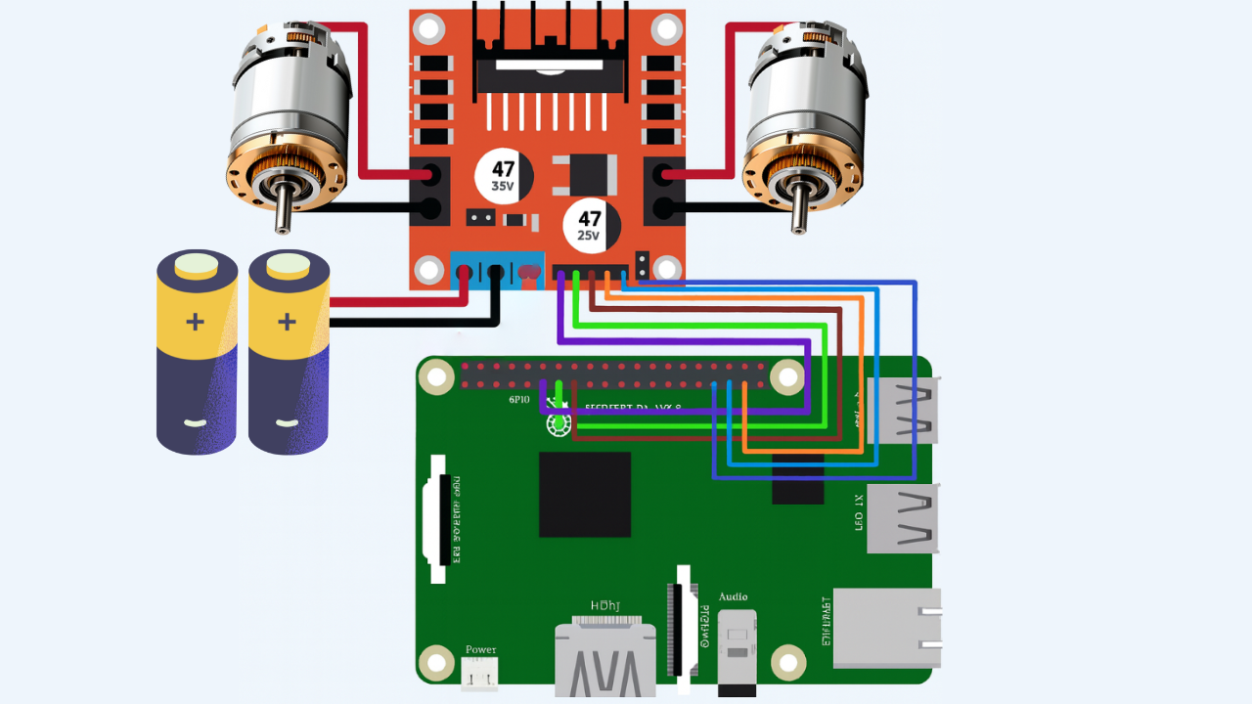
Circuit Diagram

Slide 14
Software Requirements:
REQUIREMENTS FOR SOFTWARE INSTALLATION:
Toolchain: Compiler and build tools for ESP32.
ESP-IDF: Espressif IoT Development Framework for programming ESP32.
RASPBERRY PI 4 IDE (optional): For simpler ESP32 programming.
Python 3.x: Required for ESP-IDF setup.
Drivers: CP210x or CH340 USB-to-serial drivers for board communication.
SET UP RASPBERRY PI 4 :
Setting up the RASPBERRY PI 4 requires installing the necessary software, configuring the development environment, and verifying the connection. Follow these steps for a smooth setup:

Slide 15
Gather Required Components :
Raspberry Pi 4 (4GB or 8GB RAM model)
MicroSD card (minimum 16GB, Class 10)
HDMI cable and display monitor
USB microphone and speaker (for voice input and output)
Install Raspberry Pi OS : Download the Raspberry Pi Imager tool on your computer.
Insert the microSD card and flash Raspberry Pi OS using the Imager.
Initial Boot and Configuration : Complete the setup wizard:
Select language, country, and time zone.
Connect to Wi-Fi.
Update the system when prompted
Enable Interfaces : Enable the following:
SSH (for remote access)
I2C and SPI (for sensors)
GPIO (for motor control)
Install Required Software Packages : Install Python libraries and tools needed for your project

Slide 16
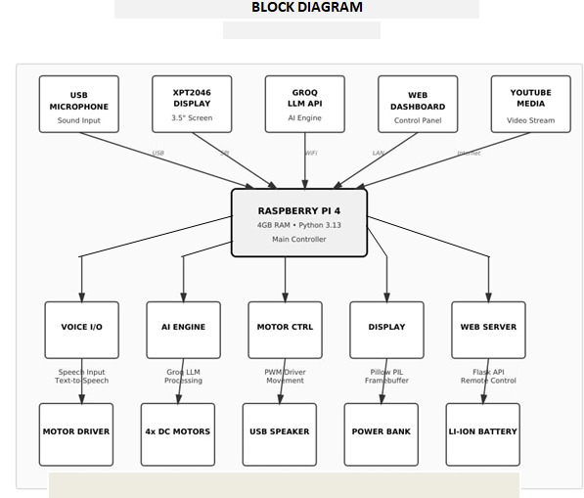
FLOW CHART:

Slide 17
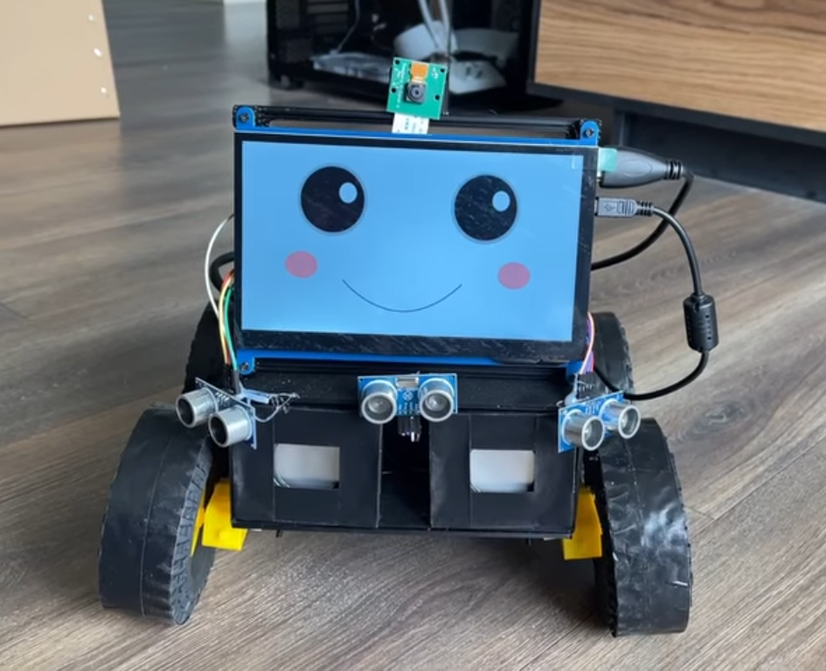
RESULT:
Smart Autonomous Robot using Chatgpt : POWER ON

Slide 18
ADVANTAGES:
Voice-Controlled Robots – Used to recognize voice commands and control robot movements.
Home Automation Systems – Automates home appliances such as lights, fans, and doors.
IoT (Internet of Things) Projects – Acts as a central controller for connected smart devices.
AI and Machine Learning Applications – Performs image recognition, speech recognition, and data analysis.
Educational Purposes – Helps students learn programming, hardware interfacing, and electronics.
Media Center – Converts any monitor or TV into a smart media system using software like Kodi.

Slide 19
Limitations:
Limited Processing Power: Not as powerful as a full desktop computer for heavy computational tasks.
No Built-in Storage: Requires a microSD card for storage, which can be slower and less reliable than SSDs.
Limited RAM for High-End Tasks: Even with 8GB RAM, it may struggle with large-scale AI or machine learning applications.
Dependent on External Peripherals: Needs monitor, keyboard, mouse, and power supply for setup and use.
Not Suitable for Real-Time Applications: Due to its operating system, it cannot guarantee precise timing control

Slide 20
APPLICATIONS:
Voice-Controlled Robots – Used to recognize and respond to spoken commands for robot control.
Home Automation Systems – Controls home appliances such as lights, fans, and doors remotely or via voice.
IoT Projects – Acts as the central controller in Internet of Things applications.
AI and Machine Learning – Runs models for image recognition, speech processing, and data prediction.
Educational Purposes – Used in schools and colleges to teach programming and embedded systems.

Slide 21
Conclusion:
The Smart Autonomous Robot using Raspberry Pi 4 demonstrates the integration of speech recognition technology with robotic control systems. This project shows how human voice commands can be used to control the movement and actions of a robot effectively. By using components such as the Raspberry Pi 4, USB microphone, motor driver, and ultrasonic sensor, the system achieves intelligent and interactive operation.
The project highlights the potential of artificial intelligence, IoT, and embedded systems in realworld automation. It provides a foundation for developing more advanced applications like home automation, assistive robots, and industrial automation systems.
Overall, this project helps in understanding how hardware and software can work together to create a smart, voice-responsive robotic system that bridges the gap between humans and machines.

Slide 22
Future Scope:
the project can be further improved by integrating artificial intelligence (ai) to make the robot understand and respond to complex commands. adding camera modules and computer vision can enable object detection, face recognition, and autonomous navigation .The robot can be connected to the internet of things (iot) network for remote monitoring and control through mobile apps or web interfaces

Slide 23
REFERENCES:
Sikorski et al. (2024). "Deployment of NLP and LLM Techniques to Control Mobile Robots at the Edge." arXiv:2405.17670.
Kanade & Alva (2020). "Review of Voice Controlled Robotic Arm-Raspberry Pi." European Journal of Electrical Engineering and Computer Science, Vol. 5, Das et al. (2018). "An IoT based Interactive Speech Recognizable Robot with Distance control using Raspberry Pi." IEEE Micro Com Conference.
Bäckström & Morales-Villarreal (2023). "A survey on integration of large language models with intelligent robots." Intelligent Service Robotics, Vol. 17.
Driess et al. (2024). "Integrating Large Language Models into Robotic Autonomy: Motion, Voice, and Training Pipelines." Remote Sensing in Robotics (MDPI), Vol. 6.
Shrestha et al. (2024). "LLM-driven agent for speech-enabled control of industrial robots." Scientific Reports.
Zeng et al. (2023). "Large Language Models for Robotics: A Survey." IEEE/CAA Journal of Automatica Sinica, Vol. 10

Slide 24
Thank you..!!

